Slide 1
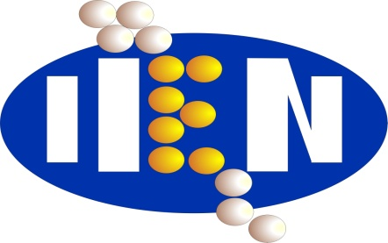


NANO-2019
30th WORLD NANO CONFERENCE
May 20-21, 2019 Zürich, Switzerland
Functional Nanostructures Superconductor/Ferromagnet for Superconducting Spintronics
Sidorenko Anatolie,
Institute of Electronic Engineering and Nanotechnologies, Kishinev, Moldova
In collaboration with:
University of Twente, Netherlands – Alexander Golubov
Stockholm University, Sweden – Vladimir Krasnov
Augsburg University, Germany – Achim Wixforth
Institute of Nanotechnology, Karlsruhe, Germany - Horst Hahn
Orel State University, Russia – Yuri Savva
Kazan State University, Russia - Lenar Tagirov
Moscow State University, Russia – Mikhail Kupriyanov
Research is done with support of the EU project “ SPINTECH - Boosting the scientific excellence and innovation capacity in spintronics of the Institute of Electronic Engineering and Nanotechnologies“, under the grant agreement Nr. 810144

